Slide 1
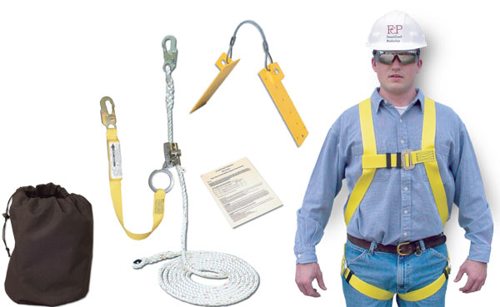
FREE TRAINING
Residential Construction Fall Protection Outreach & Overview
Falls continue to be the # 1 leading cause of fatalities for construction workers.
OVERVIEW
Fall hazard outreach for residential contractors whose workers may be exposed to falls.
REGISTRATION
Register by contacting
Joe Green - OSHA Compliance Assistance Specialist via
Email - green.joseph@dol.gov
978-837-4470
REGISTRATION REQUIRED TO ATTEND
Space is limited
WHERE & WHEN
138 River Road, Andover, MA. Suite 102
Mondays - 9:15 am – 10:30am (Session starts and doors close promptly at 9:15am)
Upcoming sessions Thursdays: October 27, 2022, November 17, 2022 and December 15, 2022

