Slide 1
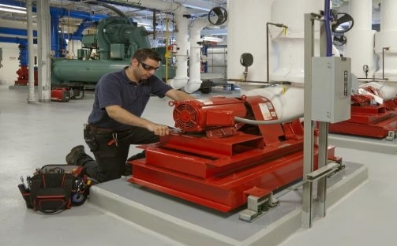
Most Frequently Cited Serious Violations
General Industry FY2021
OSHA Federal Standards
October 1, 2020 – September 30, 2021

Slide 2
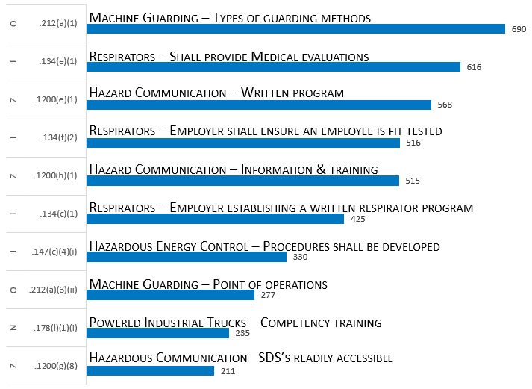
Most Frequently Cited Serious Violations in General Industry FY 2021
29 CFR 1910.
1910 Overall MFC

Slide 3
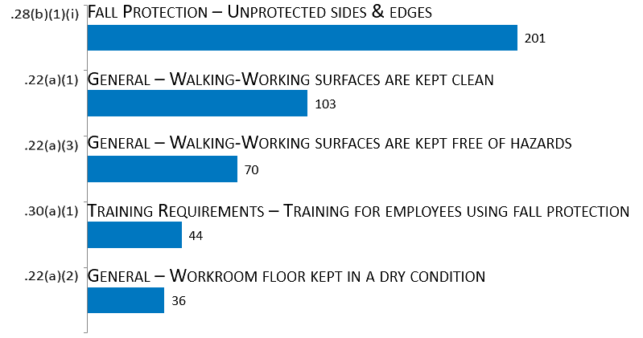
Walking-Working Surfaces [1910.21 – .30]
29 CFR 1910.
Subpart D

Slide 4
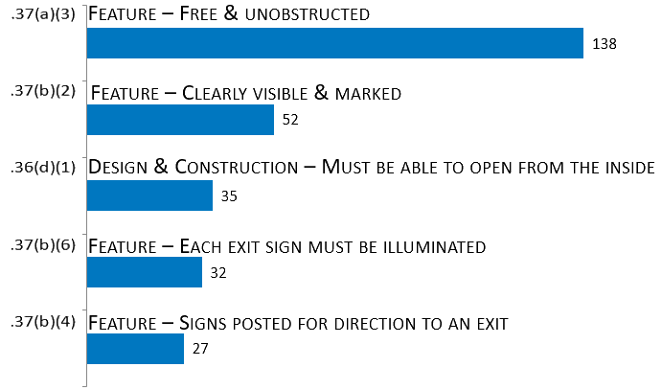
Exit Routes & Emergency Planning [1910.33 – .39]
29 CFR 1910.
Subpart E

Slide 5
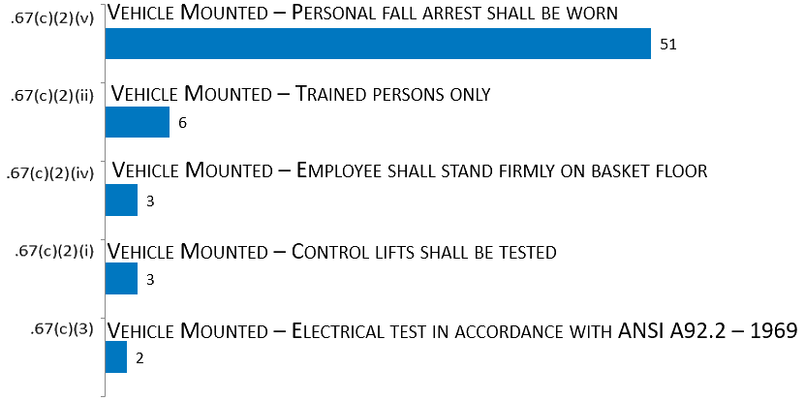
Powered Platforms, Manlifts, & Vehicle-Mounted Work Platforms [1910.66 – .68]
29 CFR 1910.
Subpart F

Slide 6
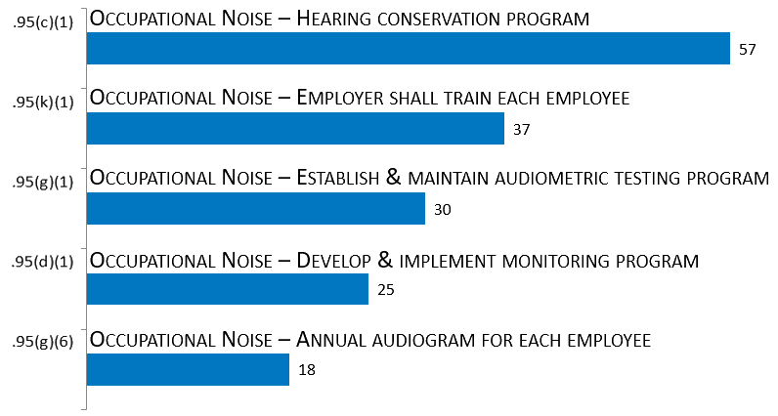
Occupational Health & Environmental Control [1910.94 – .98]
29 CFR 1910.
Subpart G

Slide 7
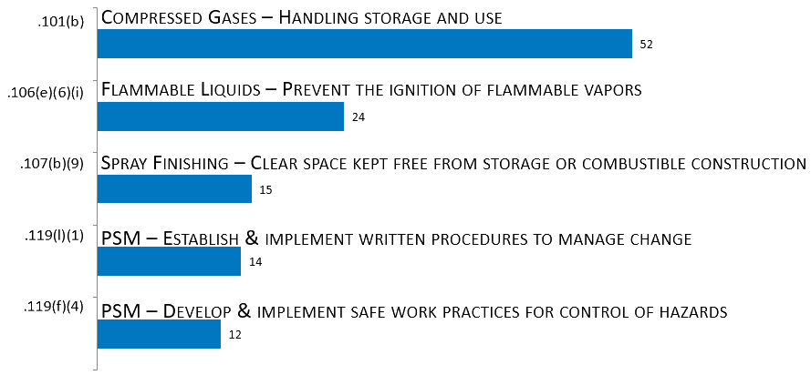
Hazardous Materials [1910.101 – .126]
29 CFR 1910.
Subpart H

Slide 8
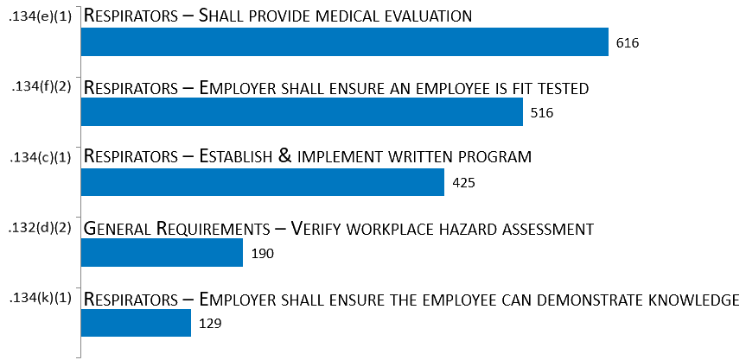
Personal Protective Equipment [1910.132 – .138]
29 CFR 1910.
Subpart I

Slide 9
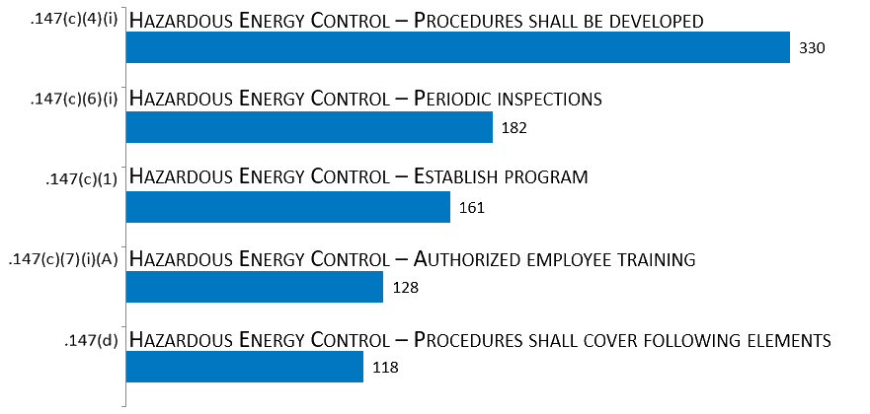
General Environment Controls [1910.141 – .147]
29 CFR 1910.
Subpart J

Slide 10
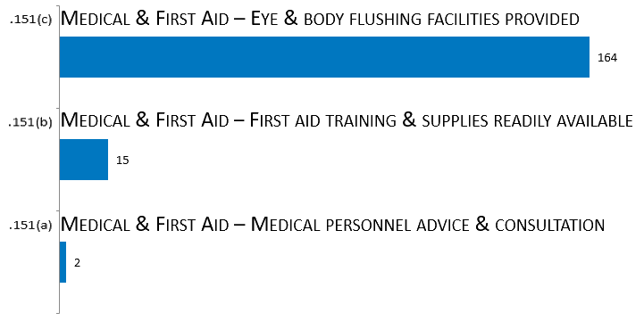
Medical & First Aid [1910.151 –.152]
29 CFR 1910.
Subpart K

Slide 11
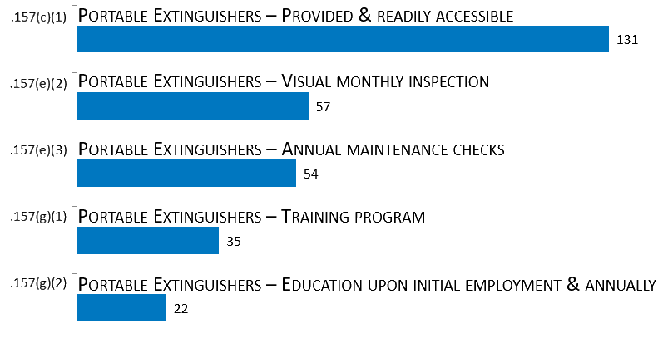
Fire Protection [1910.155 – .165]
29 CFR 1910.
Subpart L

Slide 12
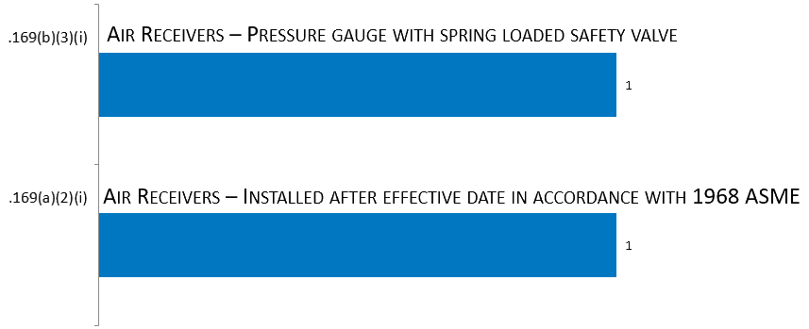
Compressed Gas & Compressed Air Equipment [1910.166 – .169]
29 CFR 1910.
Subpart M

Slide 13
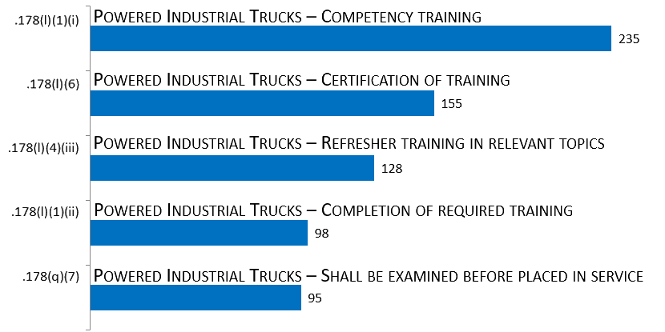
Materials Handling & Storage [1910.176 – .184]
29 CFR 1910.
Subpart N

Slide 14
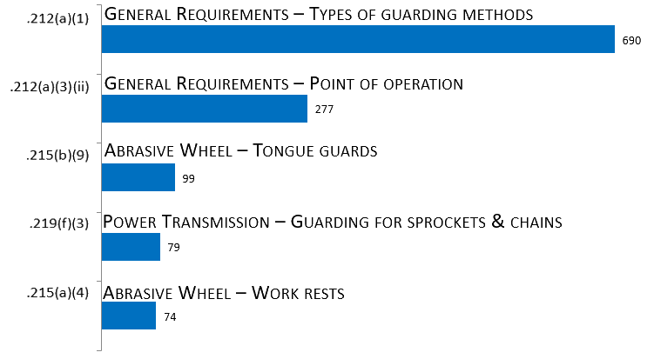
Machinery & Machine Guarding [1910.211 – .219]
29 CFR 1910.
Subpart O

Slide 15
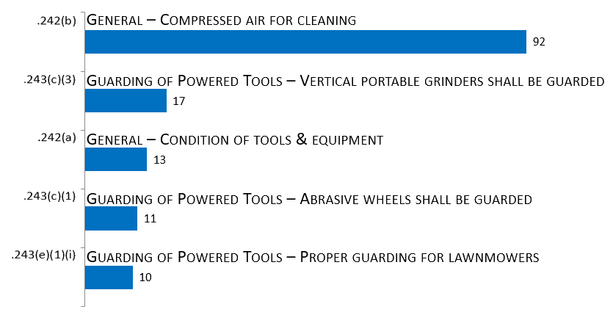
Hand & Portable Powered Tools & Other Hand-Held Equipment [1910.241 – .244]
29 CFR 1910.
Subpart P

Slide 16
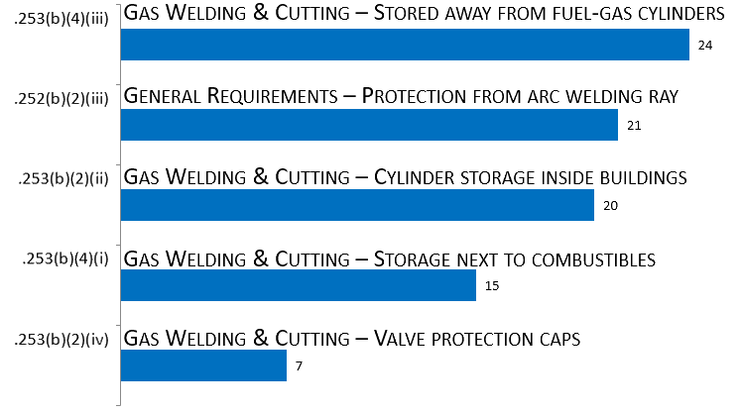
Welding, Cutting, & Brazing [1910.251 – .255]
29 CFR 1910.
Subpart Q

Slide 17
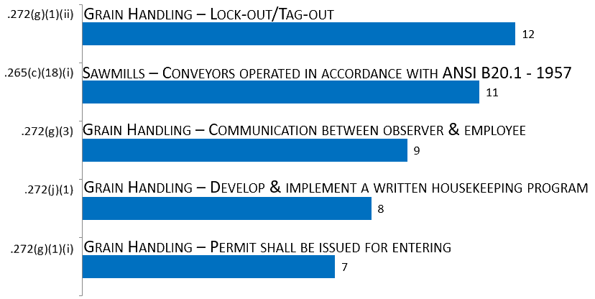
Special Industries [1910.261 – .272]
29 CFR 1910.
Subpart R

Slide 18
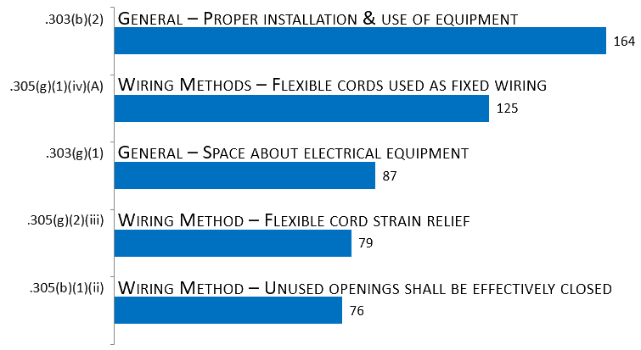
Electrical [1910.301 – .399]
29 CFR 1910.
Subpart S

Slide 19
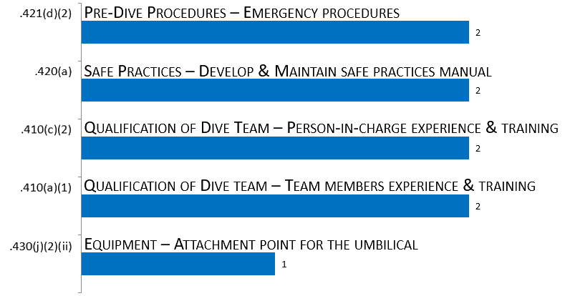
Commercial Diving Operations [1910.401 – .440]
29 CFR 1910.
Subpart T

Slide 20
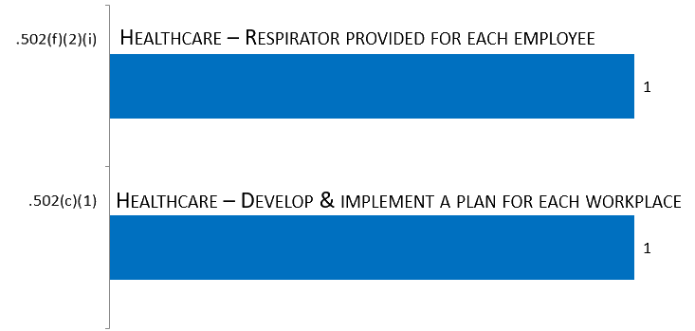
COVID-19 [1910.501 – .510]
29 CFR 1910.
Subpart U

Slide 21
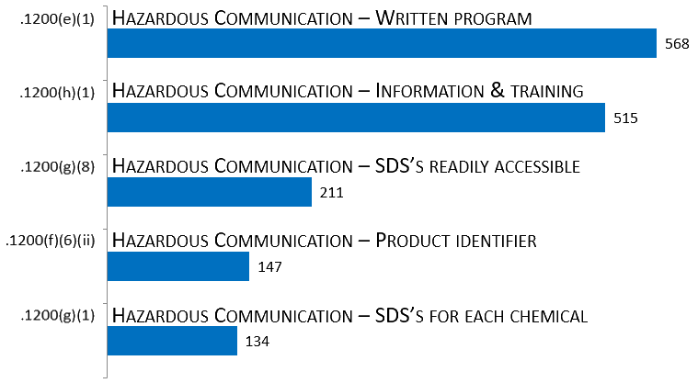
Toxic & Hazardous Substance [1910.1000 – .1450]
29 CFR 1910.
Subpart Z

