Slide 1
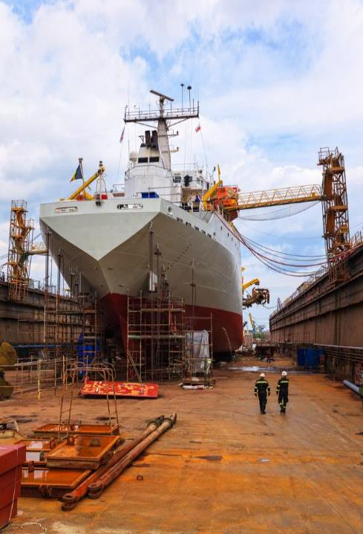
Most Frequently Cited Serious Violations
Maritime Industry FY2020
OSHA Federal Standards
October 1, 2019 – September 30, 2020

Slide 2
Most Frequently Cited Serious Violations in Shipyard Employment FY 2020
.73(d)
Subpart E – Guarding of deck opening & edges
.132(d)
Subpart h – Worn & frayed electrical cables shall not be used
.152(a)
Subpart I – Employer shall provide and ensure employees wear PPE
29 CFR 1915.
.71(j)(1)
Subpart E – Scaffolds or staging
.152(b)
Subpart I – Hazard assessment & equipment

Slide 3
Most Frequently Cited Serious Violations in Marine Terminals FY 2020
.112(b)(1)
Subpart F – Guarding of edges
.48(a)(1)
Subpart C – Danger zones at or adjacent to conveyors shall be guarded
.152(d)(1)(xvi)
Subpart G – Oxygen cylinders stored separate from gas cylinders
29 CFR 1917.
.26(f)
Subpart B – Coast guard life ring with 90 feet of line attached
.43(c)(5)
Subpart C – PIT maintained in safe working order

Slide 4
Most Frequently Cited Serious Violations in Longshoring FY 2020
.5(b)
Subpart A – Provide training on hazards and related matters
.11(a)
Subpart B – Employer shall not use the vessel’s cargo handling gear
.11(c)
Subpart B – Entries into the registers shall be made by a competent person
29 CFR 1918.
.85(e)
Subpart H – Employees prohibited from working under suspended containers
.85(l)
Subpart H – use fall protection when working next to unguarded edge

