Slide 1
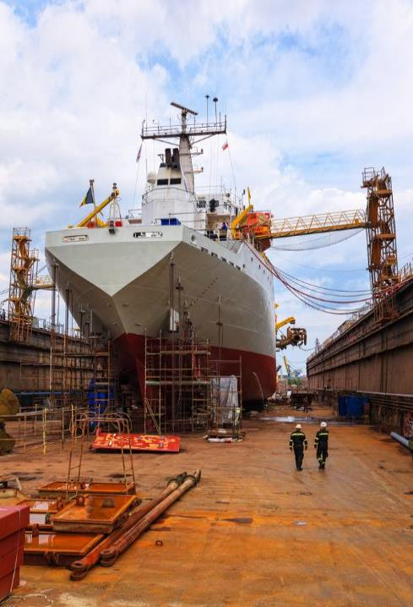
Most Frequently Cited Serious Violations
Maritime Industry FY2021
OSHA Federal Standards
October 1, 2020 – September 30, 2021

Slide 2
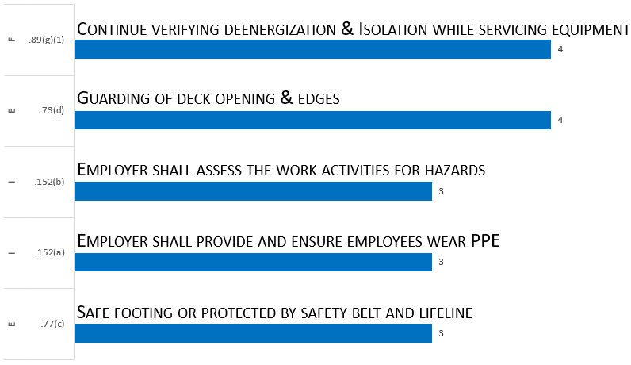
Most Frequently Cited Serious Violations in Shipyard Employment FY 2021
29 CFR 1915

Slide 3
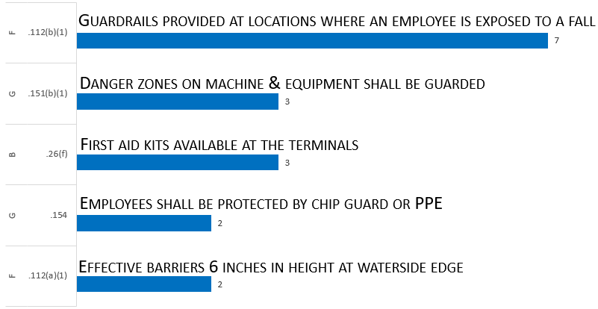
Most Frequently Cited Serious Violations in Marine Terminals FY 2021
29 CFR 1917

Slide 4
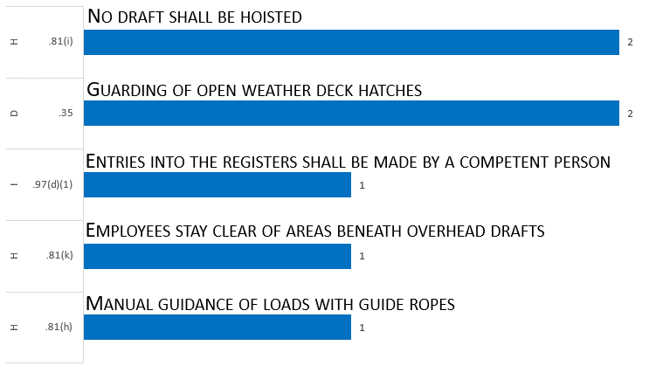
Most Frequently Cited Serious Violations in Longshoring FY 2021
29 CFR 1917

